Slide 1


Task Management System in Java
A simple yet efficient system for managing tasks, built using Java's Object-Oriented Programming principles.

Slide 2
Task Class: Representing a Task
Responsibilities
Key Methods
Represents a single task with its name, description, and completion status. Provides methods to access and modify these attributes.
Getters and setters for name, description, and isCompleted. toString() method for a textual representation of the task.

Slide 3
TaskController: Managing Tasks
Responsibilities
Features
Manages a list of Task objects, providing methods to add, retrieve, and mark tasks as completed.
Maintains an indexed list of tasks for efficient access and retrieval.

Slide 4
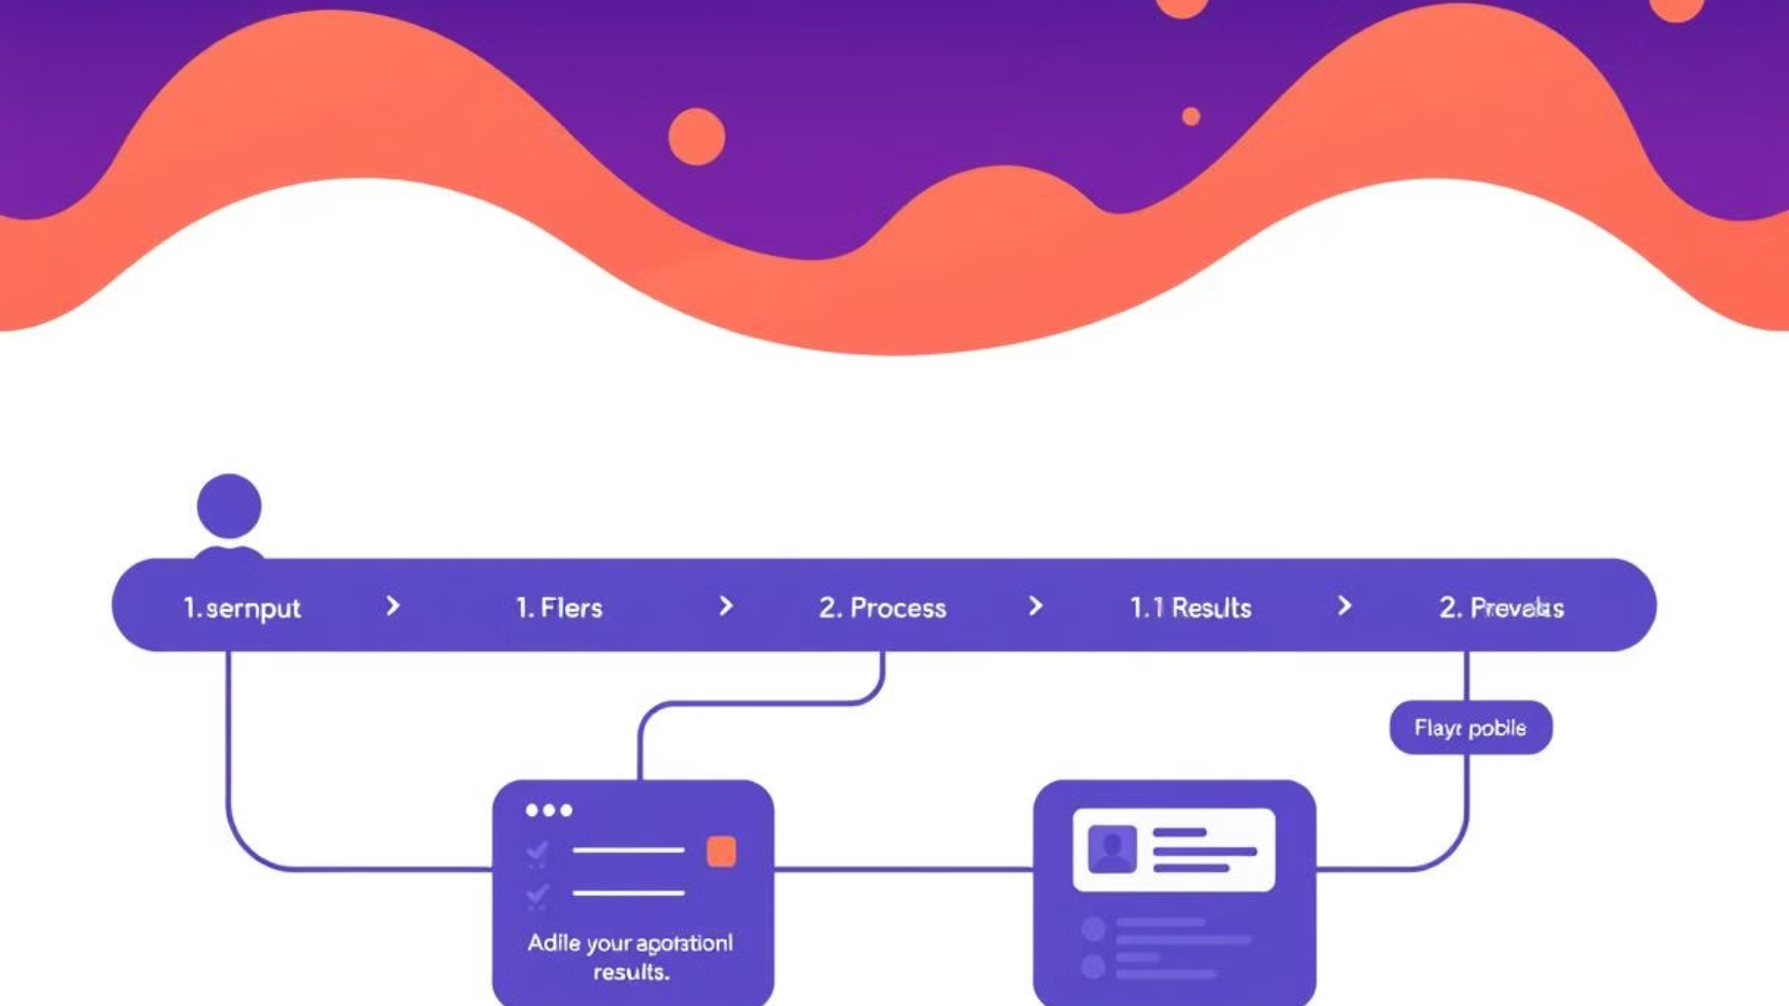
TaskManagementSystem: The Main Application
Displays a menu with options to add, view, complete tasks, and exit.
Calls methods from TaskController based on user choice to manage tasks.
1
2
3
Reads and validates user input using Scanner.

Slide 5
Features of the System
Add Task
View Tasks
Allows users to input a task name and description, creating a new Task object and adding it to the list.
Displays all tasks with their index and status (completed or not).
Complete Task
Exit
Lets users select a task by index and marks it as completed by updating its isCompleted status.
Terminates the program gracefully.

Slide 6
Code Snippets
Task Class
TaskController Class
public class Task { private String name; private String description; private boolean isCompleted; public Task(String name, String description) { this.name = name; this.description = description; this.isCompleted = false; } }
public void addTask(String name, String description) { tasks.add(new Task(name, description)); }

Slide 7




Execution Flow
Program Start
1
Displays the menu of options.
User Selection
2
Validates input and calls the appropriate methods.
Task Management
3
Adds, views, or updates tasks based on user actions.
Exit
4
Terminates the program when the user chooses to exit.

Slide 8


Error Handling
Invalid Input
Solution
Handles cases like non-integer menu choices or invalid task indices when marking a task as completed.
Uses try-catch blocks to handle NumberFormatException and boundary checks to ensure valid task indices.

Slide 9
Advantages of the System
User-Friendly
1
Provides a simple text-based interface that is easy to understand and use.
Efficient
2
Handles task operations efficiently with minimal complexity.
Extensible
3
Can be extended with additional features like deadlines, task priorities, or persistence to a database.

Slide 10

Conclusion
1
2
Summary
Future Improvements
This project successfully implemented a basic task management system in Java, demonstrating key Object-Oriented Programming principles.
Explore integrating a database for task persistence, enhancing the user interface with a GUI, and adding features like task prioritization.

